Slide 1
CS 6120
Week 2: Review - Core Concepts and Foundations
Notes:
Difference between our work is simply that it’s the application of algorithms.

Slide 2
Administrivia
Room request for new HVAC
Reviewing reading group sign-ups
  Currently 36 students have signed up
  Updated times and papers (54 total students)
Last week’s recitation: Python Review
This week’s recitation: Foundations of Linear Algebra
  Time / Date / Room

Slide 3
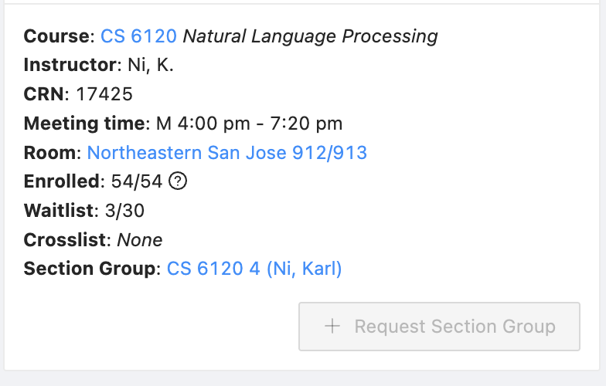
Administrivia
Course Waitlist Status
If you are not enrolled, please
e-mail me.
If you have recently enrolled, DM me / TA’s so that you are synced to Teams
Check Gradescope to see if you can access assignments
Attendance by code: Qwickly

Slide 4
Administrivia - Due Today and Due Soon
Due Before Any Absences:
  Send e-mail to instructor / TA’s for any absences
Due Today:
  Homework 1: How was it? How would you rate the level of difficulty? Homework in Python only. Please use the assignment templates. (They will always be there for any assignment).
  Laboratory 1: Does everyone have access to the GCP credits?
Due Soon
  Reading Group Sign-Up - Access Here (Please by EOW)
  Next week is the first reading group
  Homework 2 is very difficult. Please start early
  Project Groups and Sign-Ups

Slide 5
Administrivia - Course Resources
New Teams Channel: SPIE Applications of Machine Learning
Please add your ideas to the channel
Final 2 Sets of Recitations: Please Attend If Interested!
Sessions Left
Week | Class Topic | HW Due | Recitation Topic
1 | Introduction & Applications of NLP |  | Intro to Python
2 | ML Foundations & Software Engineering | Autocorrect | Linear Algebra
3 | Language Classification |  | Multivariate Calc
4 | Text Processing Algorithms | Text Classification | Intro: TF / Keras

Slide 6
Administrivia - Today’s Agenda
A Crash Course in Machine Learning - Soup to Nuts
Reviewing Logistic Regression: Python code and derivations
This week will overlap a bit with next week

Slide 7
Natural Language Processing
Section 0: Administrative
Projects and Process
Section 1: Software Engineering
Docker and deployment
Google Cloud Platform (GCP)
Python and DNN toolboxes
Section 2: Machine Learning
Linear algebra
Multivariate calculus and the chain rule
Gradient descent & backpropagation

Slide 8
Section 1: Some Basic Software Engineering
Docker and deployment
Python Environments & the Cloud
Deep Neural Network Toolboxes

Slide 9
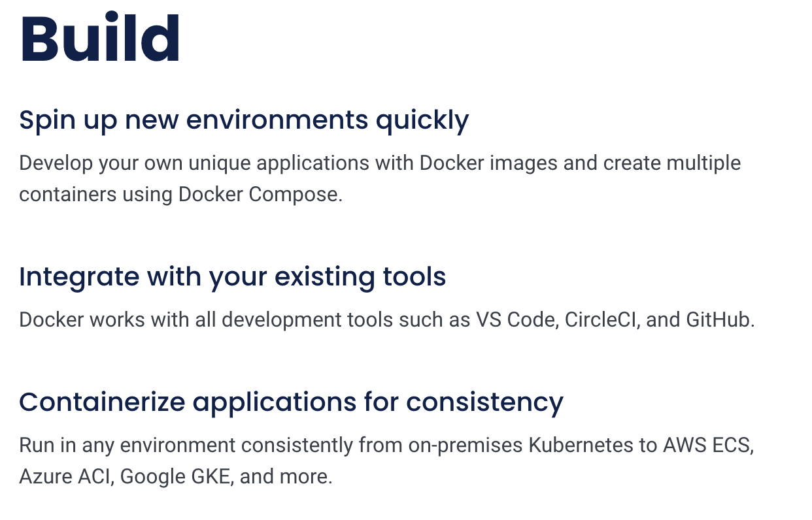

Docker Containers
What is Docker?

Slide 10
Why learn about Docker?
Portability. Docker makes it easy to move applications between different environments, such as from a developer's laptop to a production server, without having to worry about compatibility issues. It's always easy to pass a single Docker image than multiple executable files, JAR files, etc.

Slide 11
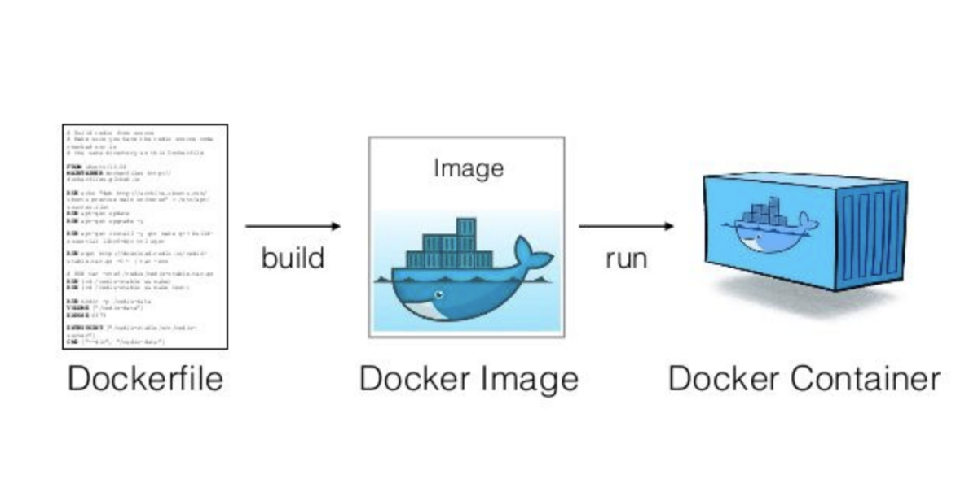
Dockerfiles, Images, and Containers

Slide 12
What can I use Docker for?
Fast, consistent delivery of your applications
  Pass to the customer executable environment
Deployment and scaling
  Enclosed environment passed to all cluster machines
Running more workloads on the same hardware
  Docker is lightweight and fast

Slide 13
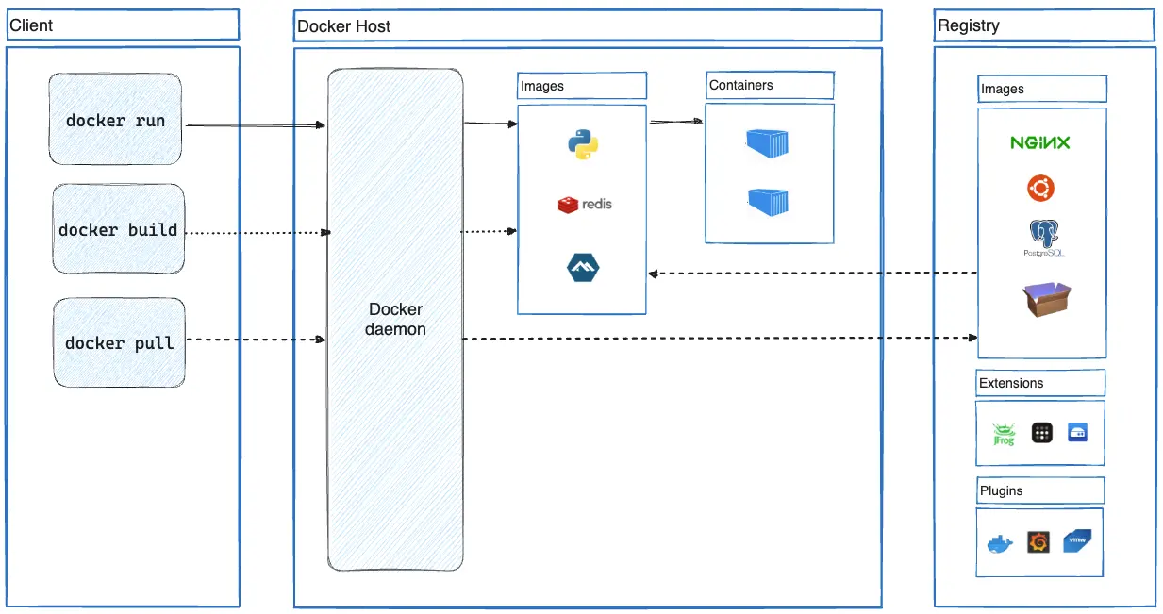
Docker Architecture

Slide 14
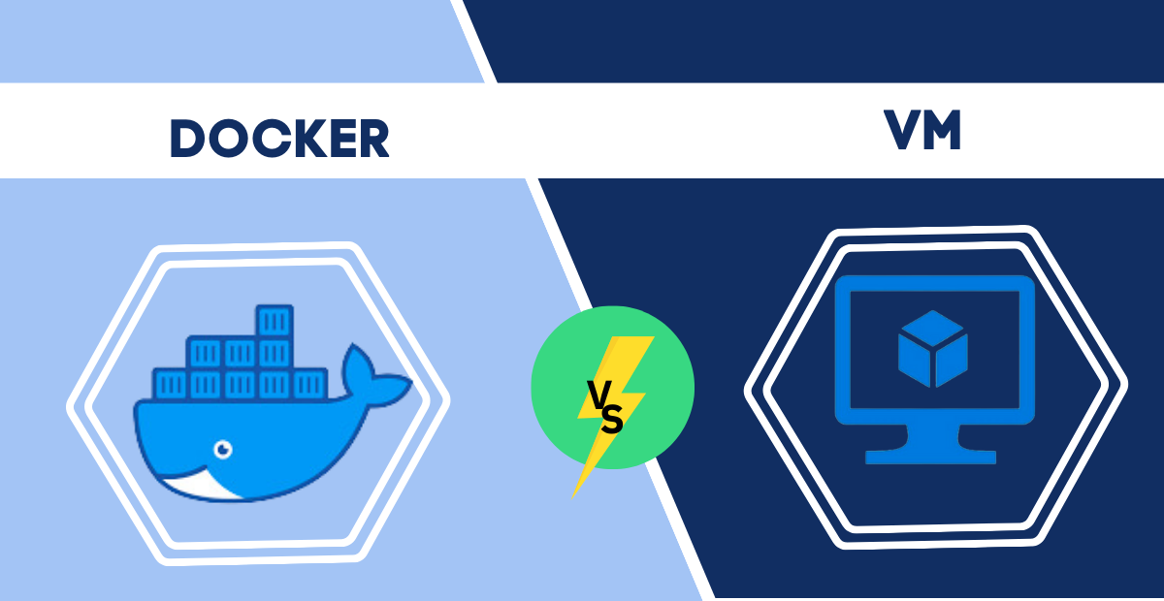
Docker vs Virtual Machines

Slide 15
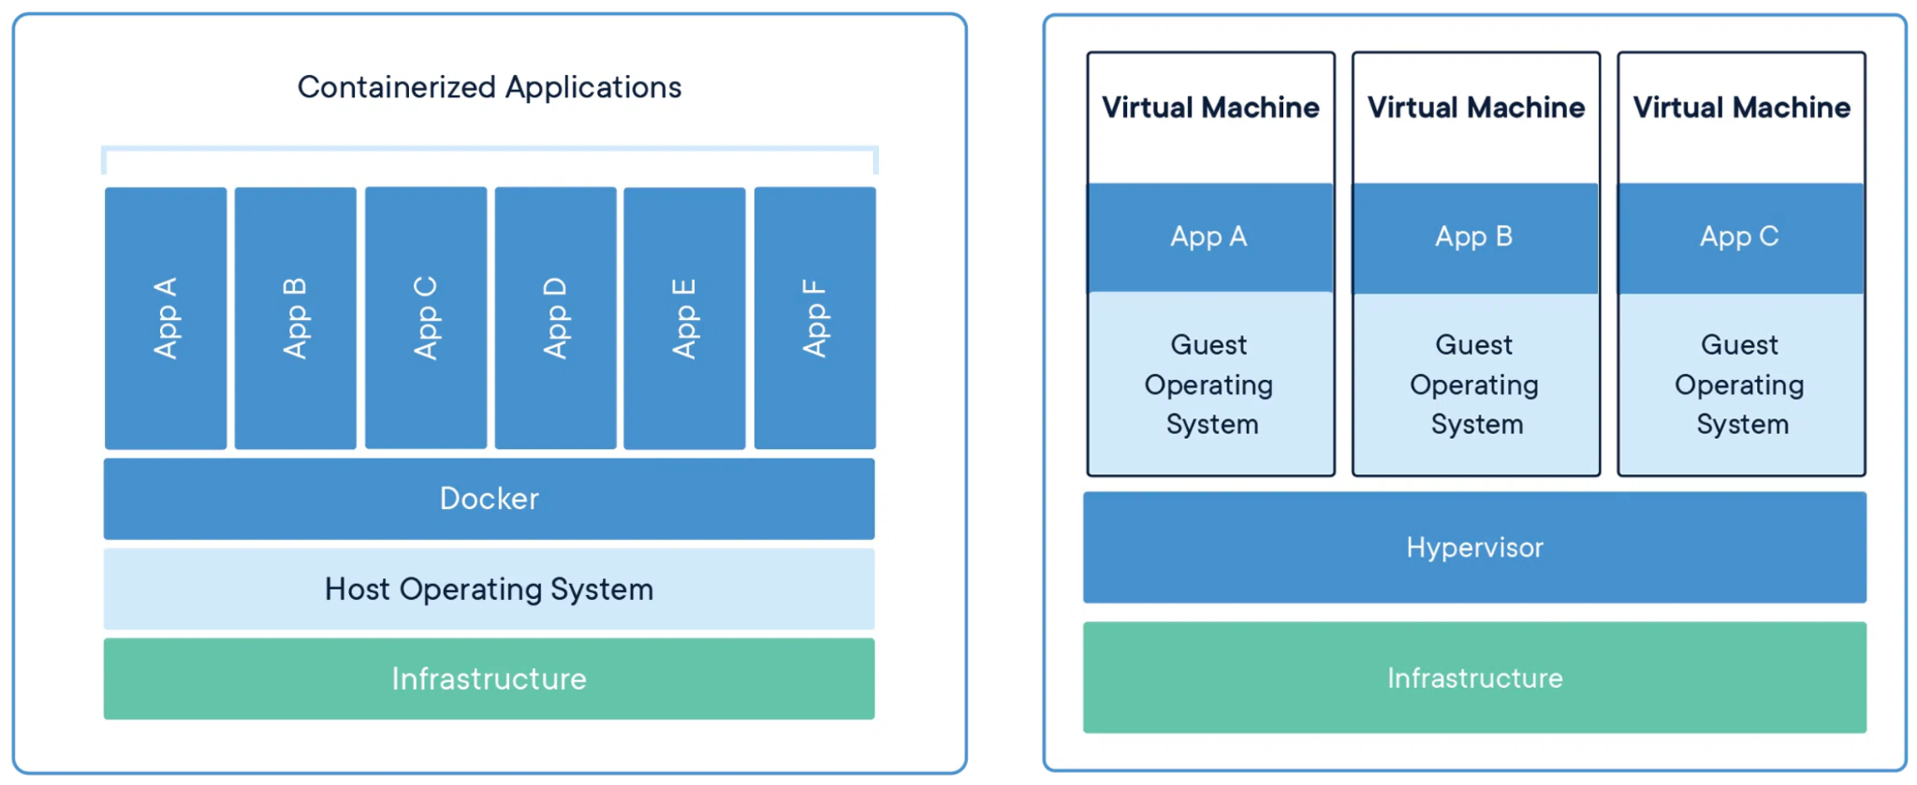
Under the Hood

Slide 16
Some Useful Docker Commands
# Comment
docker build -t <docker_image> <dir>
-t tag your image name
docker run --rm -v <>:<> -p <>:<> -it <docker_image> <command>
--rm remove image after running
-v mount a folder to make available to your container
-p expose a port
docker exec -it <docker_container> <command>
-i interactive mode

Slide 17
Your Second Lab: Docker
Using the instructions here
  Install Docker
  Create a Dockerfile
  Build a Docker image
  Run a Docker container
  Try out the volume and ports Qs

Slide 18
Section 1: Some Basic Software Engineering
Docker and deployment
General Cloud Infrastructure
Deep Neural Network Toolboxes

Slide 19

Vertex AI Studio
Prompt engineering & prototyping
Fine-tune foundation models on your own data
Work with multimodal models like Gemini
Vertex AI Studio is integrated with the full Vertex AI platform
Compliant with enterprise-grade security & data governance

Slide 20
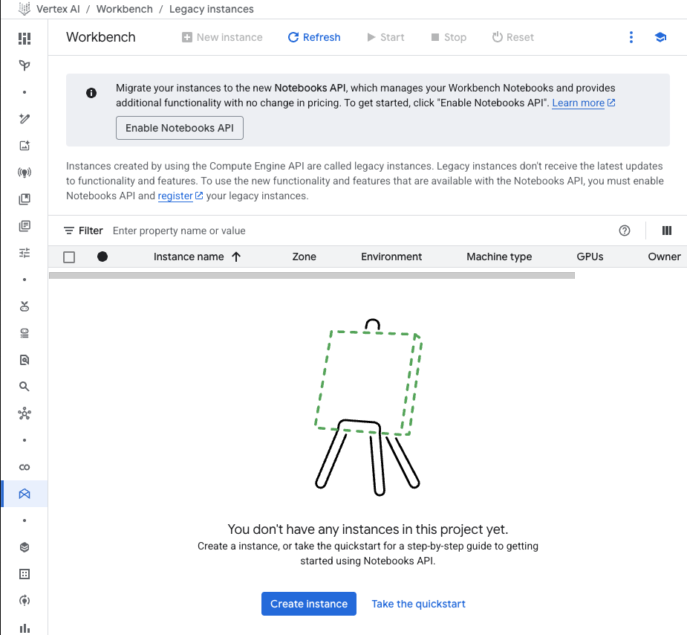
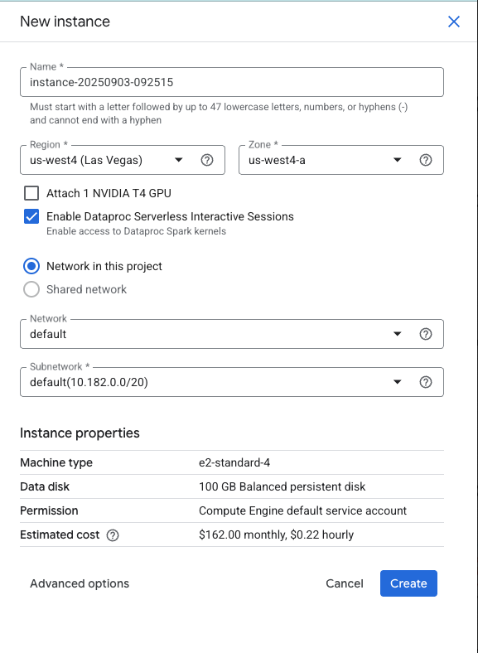
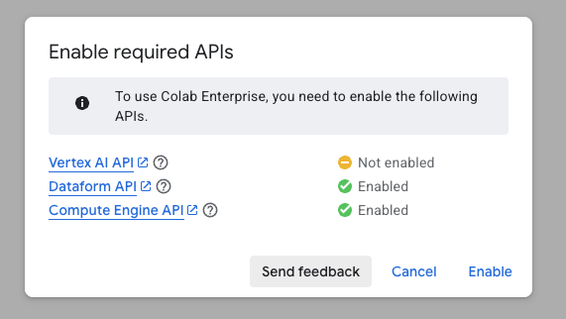
Jupyter Notebooks and Dev Environments

Slide 21
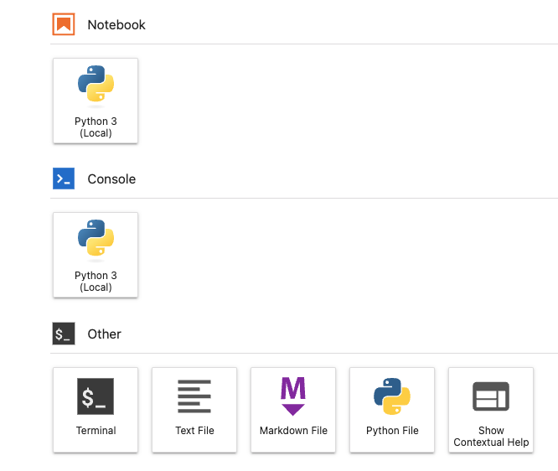
Jupyter Lab
https://console.cloud.google.com/vertex-ai/workbench/user-managed
good for prototyping and visualization
trying out files, etc.
shell: installation, and general ops
other goodies

Slide 22
Section 1: Some Basic Software Engineering
Docker and deployment
Python Environments & the Cloud
Deep Neural Network Toolboxes

Slide 23
Natural Language Processing
Section 0: Administrative
Projects and Process
Section 1: Software Engineering
Docker and deployment
Google Cloud Platform (GCP)
Python and DNN toolboxes
Section 2: Machine Learning
Fundamental concepts of Machine Learning
Linear algebra
Multivariate calculus and the chain rule
Gradient descent & backpropagation

Slide 24
Application & Theory of Machine Learning
NLP is all about ML!
Machine Learning
Input
Output
Notes:
(1980s-90s, Statistical Approaches), 2010 - Neural Language Models.
Davis Wolfgang Hawke: A notorious, Jewish-born neo-Nazi who became a major player in the spam industry. The book chronicles his rise as a "spam king," particularly in the market for male enhancement pills, which made him a millionaire and the target of lawsuits.
Susan Gunn: A computer novice who becomes a "cyber-vigilante." The book tells her parallel story, as she is drawn into the "spam wars" and her volunteer work puts her on a collision course with spammers like Hawke.
Alan Ralsky's activities as a spammer spanned a significant period, beginning as early as 1996. He was known for his high volume of spam emails, at one point reportedly sending as many as 30 million a day by 2001. After an interview with a newspaper was posted online, leading to his address being shared, and hundreds of people signing him up for mailing lists and free catalogs as a form of retaliation.

Slide 25
Training a Model
What can the mystery box be? What are some examples?
Linear regression → fitting a line to data
Polynomial regression → fitting a nonlinear line to data
Classification → prediction the different classes
Transformer-based Classification → prediction with attention

Slide 26


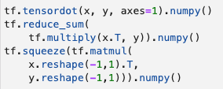

Numpy, Tensorflow, PyTorch
Dot product:
Implementations:
numpy
tensorflow
pytorch
Colab

Slide 27
Machine Learning
Training Examples
{(x₁, y₁), (x₂, y₂), … (x_{n}, y_{n}) }
F (x, y ; params)
x
ŷ
Training pairs (x_{i}, y_{i}), where x is an input and y is the output. We can create a function F that we use to predict an output ŷ given an input x. To get the parameters of the function, we use a process called training (i.e., machine learning).

Slide 28
Machine Learning
Training Examples
{(x₁, y₁), (x₂, y₂), … (x_{n}, y_{n}) }
F (x, y ; params)
x
ŷ
What would y be? (What are some examples of labels / classes / output?)
What can x be? (What are some examples of features / input?)

Slide 29
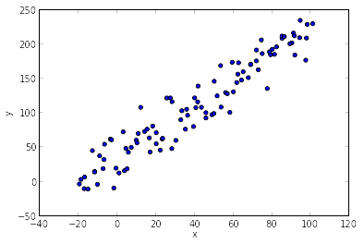
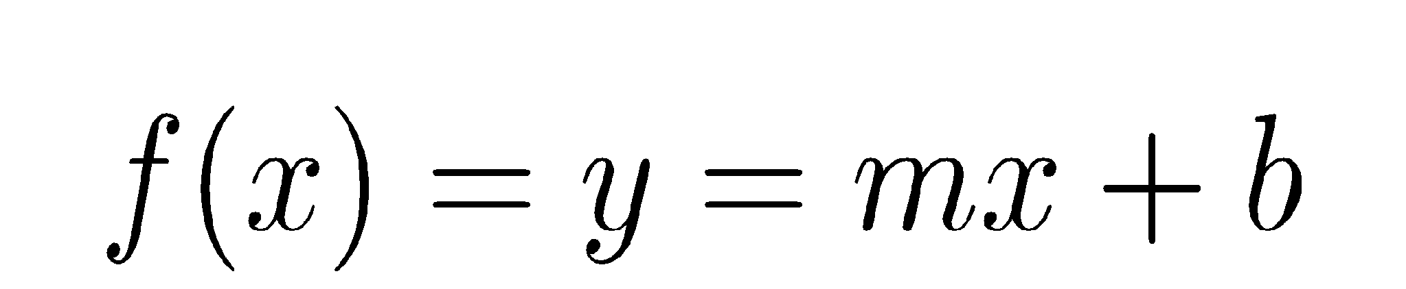
Linear Regression
What type of relationship does the plot look like to you?
Can you guess what the parameters for m and b are?
How would you solve for them?

Slide 30
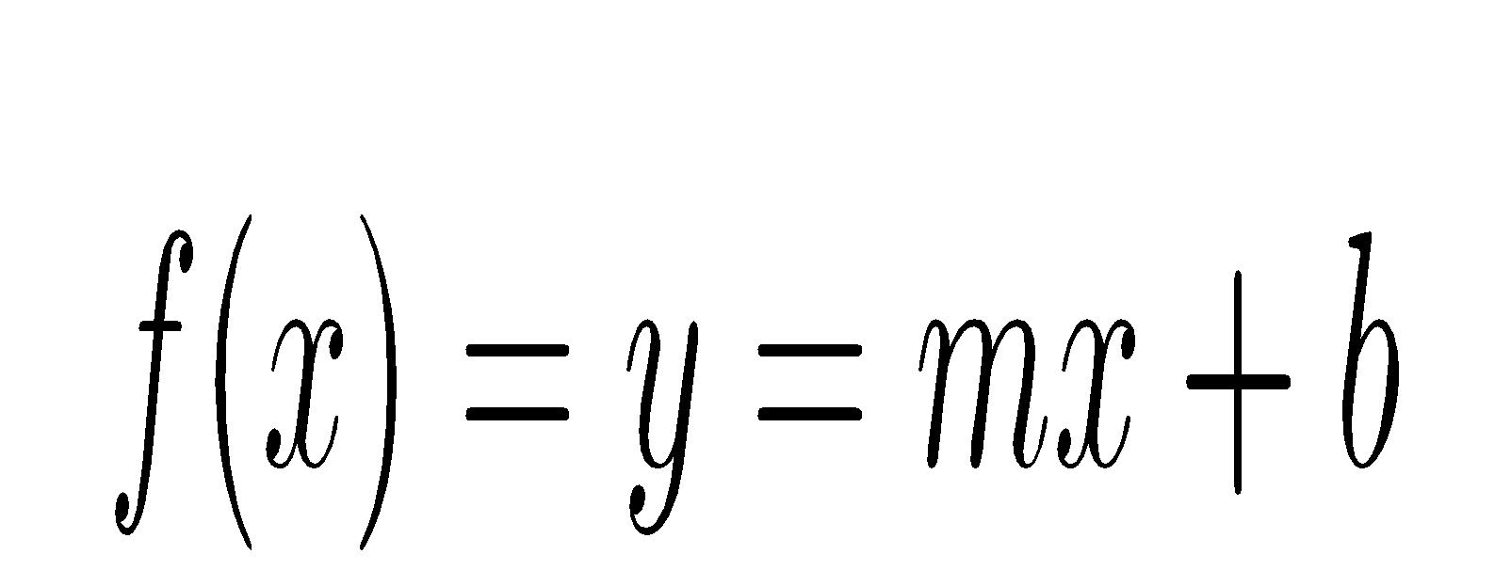
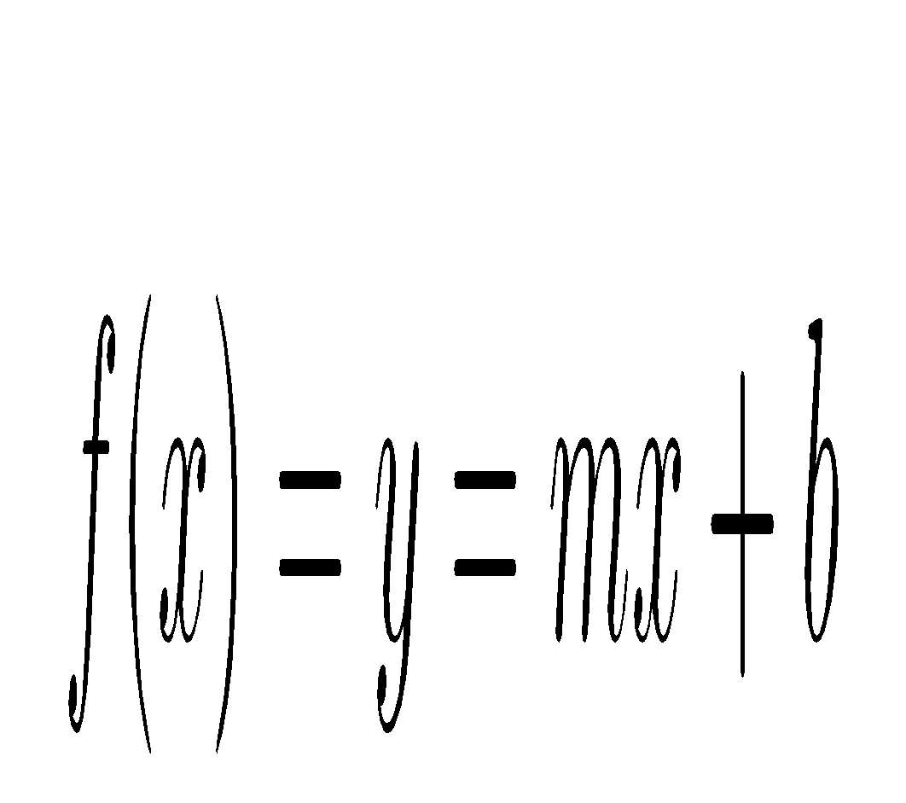
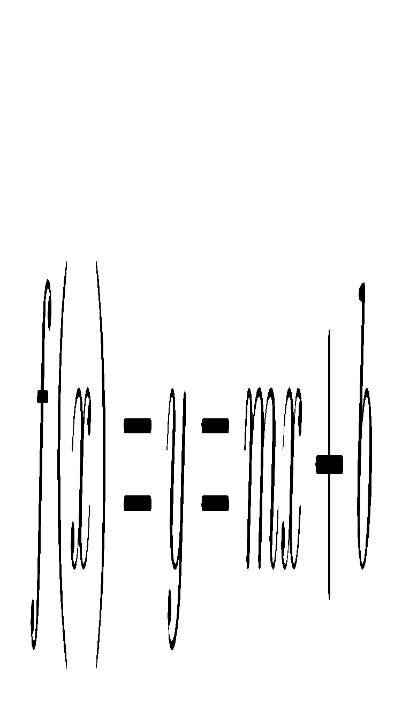
Loss Functions and Gradient Descent
Housing Prices
Proximity to city center
Consider, we’d like to minimize the distance to our prediction if it lies on a line
What might the cost function look like?
Notes:
Cost function measures how well our model fit the data

Slide 31
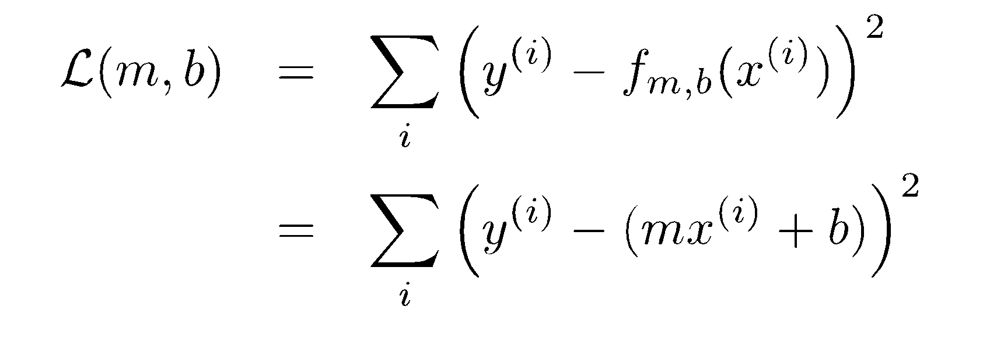
Defined Cost Function
Training Dataset
Mean Squared Error:
y
x

Slide 32


What are some cost functions?
Mean Squared Error?
Binary Cross Entropy?
Notes:
\mathcal{L}_{bce} = \sum_i \textbf{y}_i^T \log \hat{\textbf{y}}_i + (1 - \textbf{y}_i)^T \log (1 - \hat{\textbf{y}_i})

Slide 33
Using Linear Regression w/the Classification Problem?
Did you pass
the class?
1
How much sleep did you get? (hours)

Slide 34
Using Linear Regression w/the Classification Problem?
You could threshold one
whether or not it’s closer
to 0 or to 1…seems reasonable
Did you pass
the class?
1
How much sleep did you get? (hours)

Slide 35
Larger Confidence Features Skew Thresholding
Did you pass
the class?
1

Slide 36
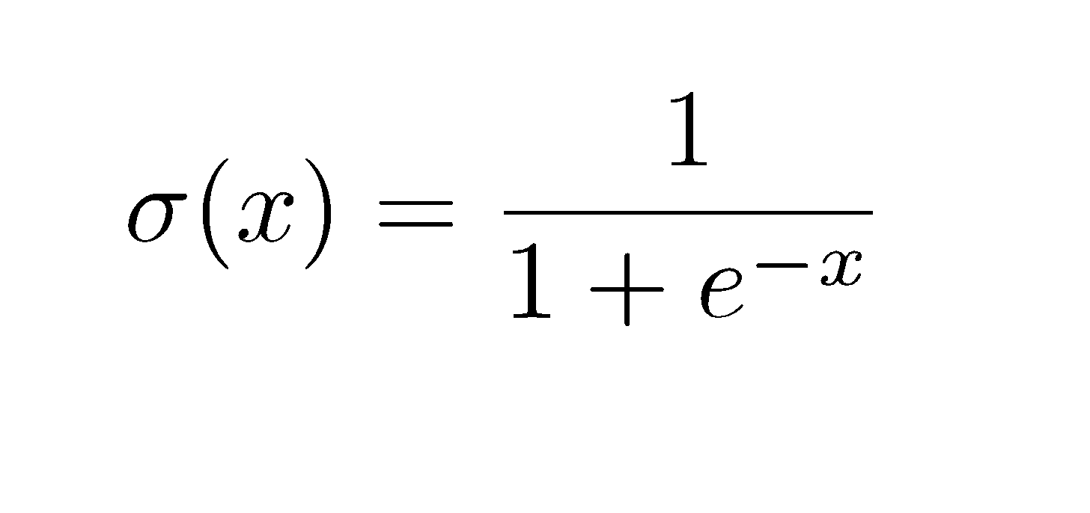
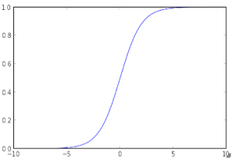
Fitting with a Sigmoid Function
The sigmoid function is defined by:
  Here e = 2.7182818284590451
It looks like this:
It’s bounded by 0 and 1.
This is a nonlinearity (not a straight line), often called a type of “activation function”

Slide 37
Larger Confidence Features Skew Thresholding
Question: What is the value of the offset?
Question: What is the m do to your sigmoid function
Did you pass
the class?
1
Offset

Slide 38
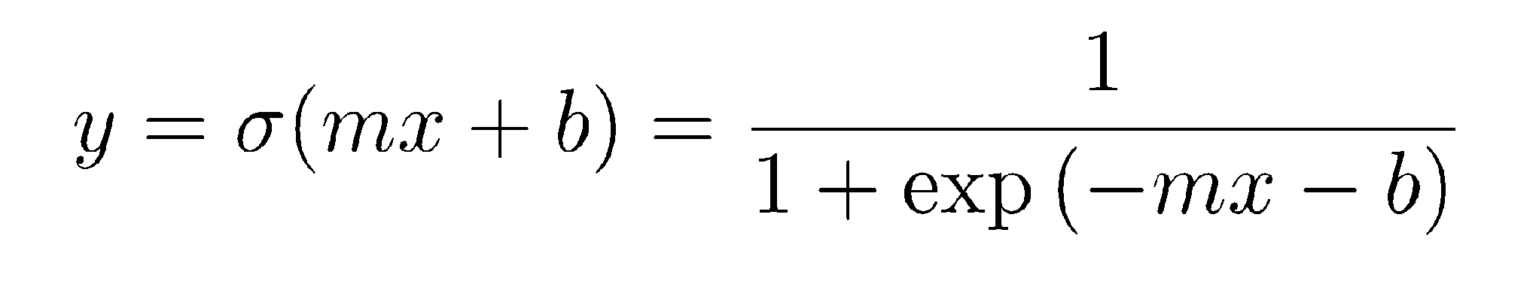
Utilizing the sigmoid function
Add sigmoid to function
Here, m is the slope / direction of 0 / 1 assignment and b is the offset
In multiple dimensions, this is very powerful
Unfortunately, you cannot solve it (w/MSE or otherwise) analytically (i.e., take the gradient and set it to zero)

Slide 39
Other Activations
Rectified Linear Units (ReLU)
Hyperbolic tangent functions (tanh)
Softmax activation (softmax)
Linear activation
An activation function is any nonlinearity that can be applied to a linear function to gain complexity in representation.

Slide 40


Classification
Did you pass the course?
How much did you
study?
How much did you play?

Slide 41
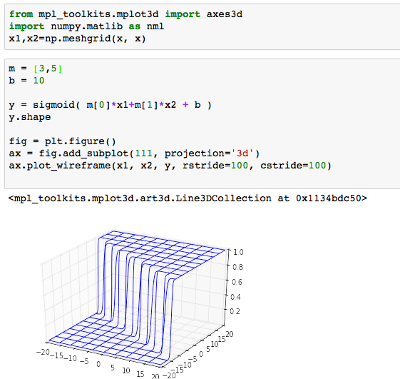
The Sigmoid Function in 2-D
Inference:
Anything above a threshold is a positive sample
Anything below a threshold is a negative sample

Slide 42
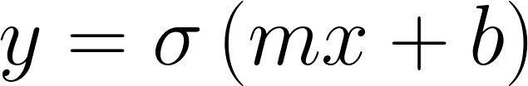
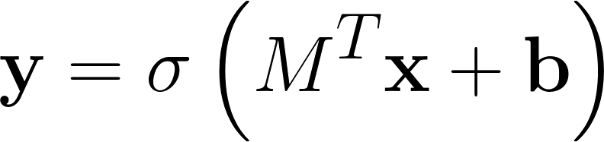
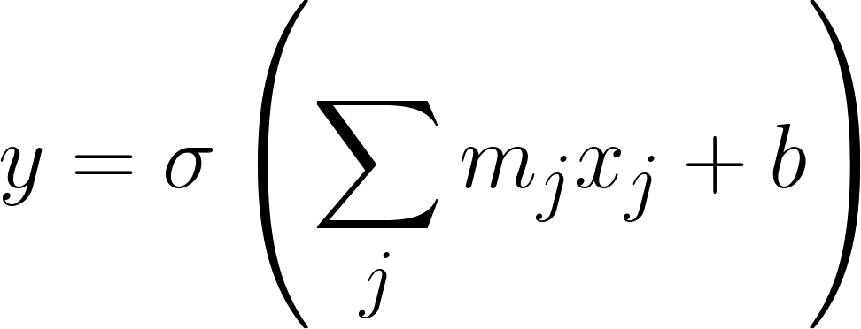
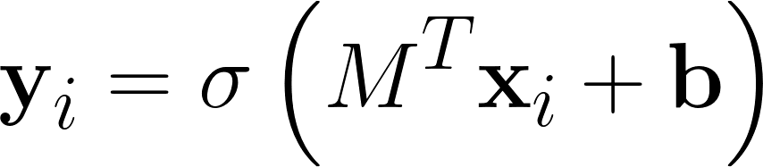
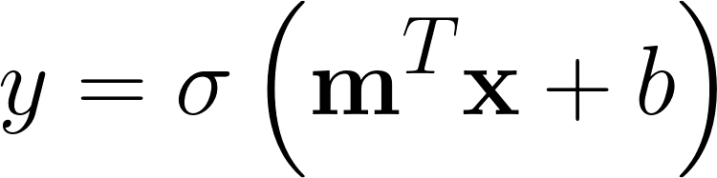
In Vector Notation
Scalar notation
Multiple input dimensions scalar notation
Vectorized multiple input dimensions
Multiple input / multiple output dimensions (might be used for inference)
Multiple data points

Slide 43

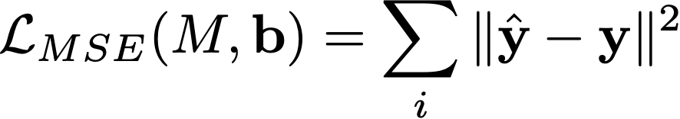
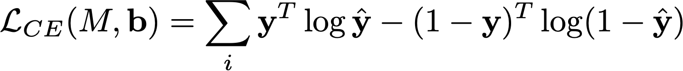


Loss Functions

Slide 44
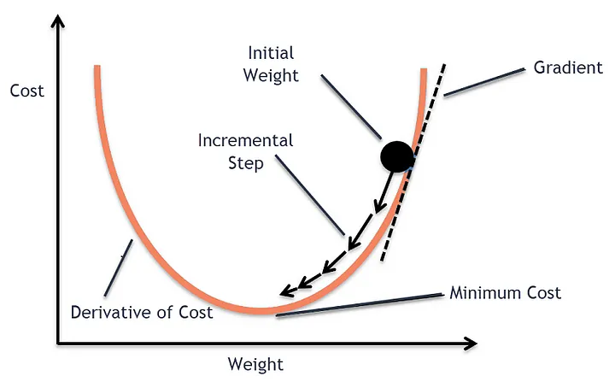
Why solve with gradient descent
Solving the systems of equations may not be feasible by setting derivatives equal to zero
A lot of times we have too many parameters and the function is very complex
Notes:
Get stuck with exponent and sigmoid function → try to take the inverse?

Slide 45
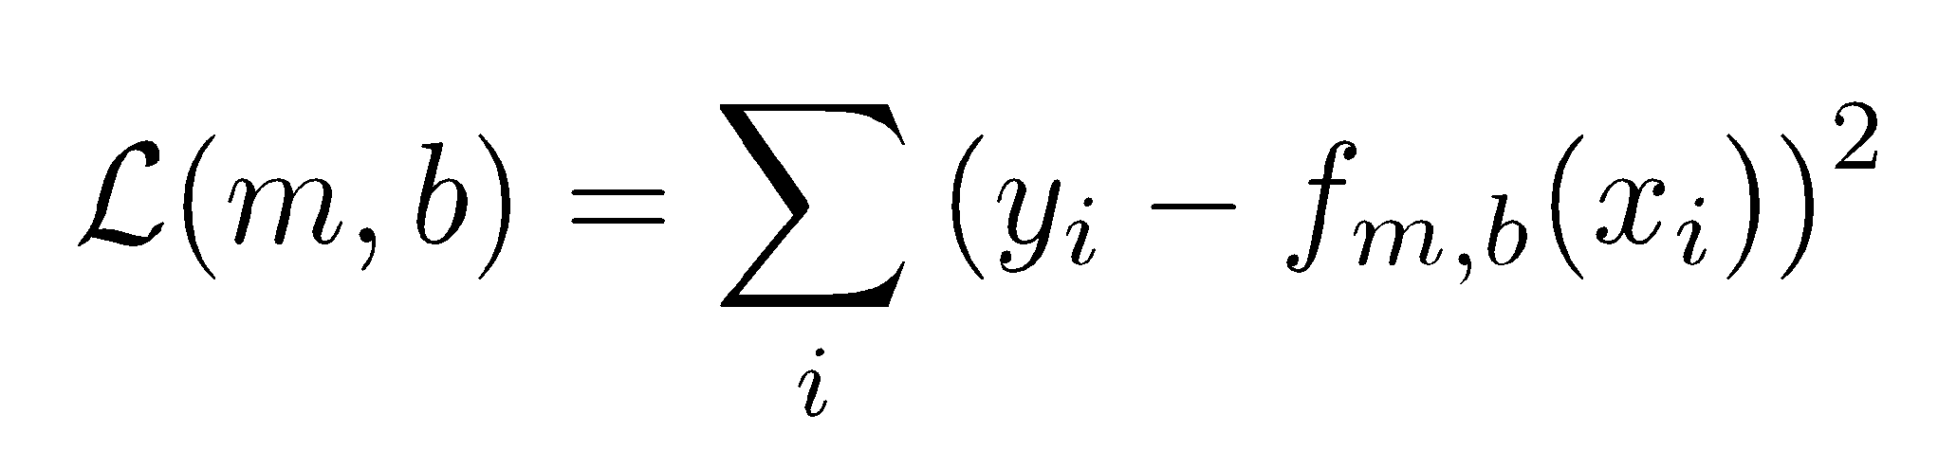
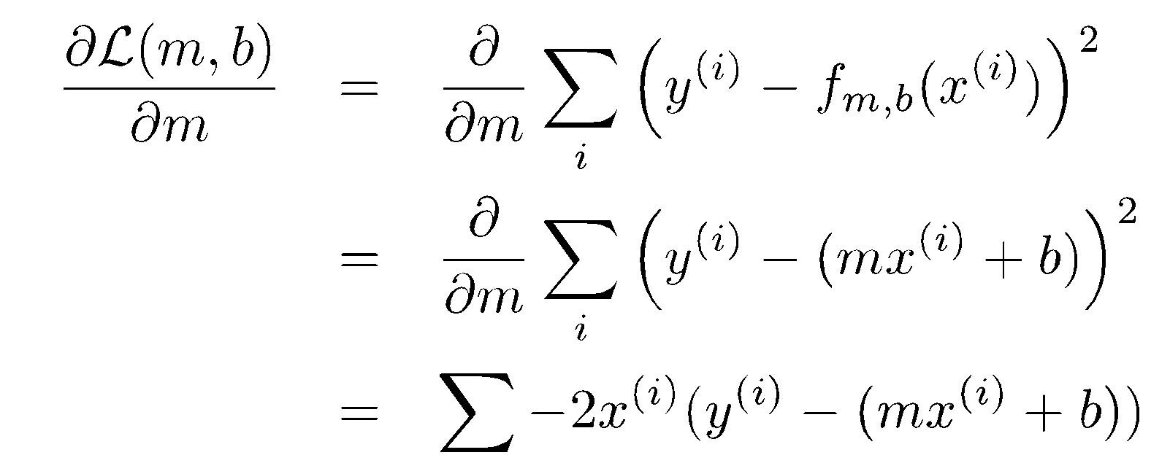
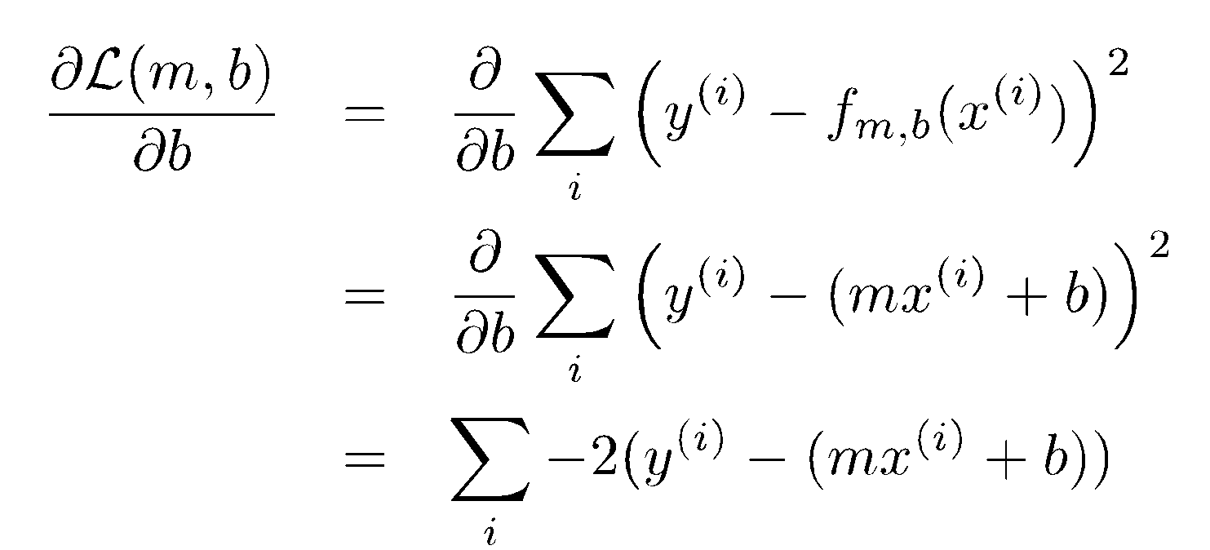
Derivatives
Gradient of
You can set the derivative to zero and solve the systems of equations
Userful for gradient checking: http://www.ee.ic.ac.uk/hp/staff/dmb/matrix/calculus.html

Slide 46
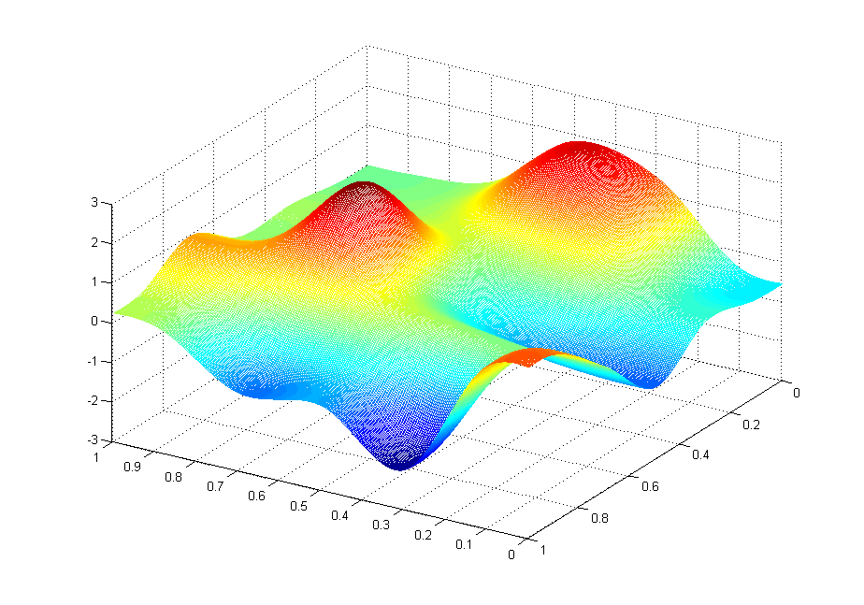
J(θ₀,θ₁)
θ₁
θ₀

Slide 47
J(θ₀,θ₁)
θ₁
θ₀

Slide 48
J(θ₀,θ₁)
θ₁
θ₀

Slide 49
J(θ₀,θ₁)
θ₁
θ₀

Slide 50
J(θ₀,θ₁)
θ₁
θ₀

Slide 51
J(θ₀,θ₁)
θ₁
θ₀

Slide 52
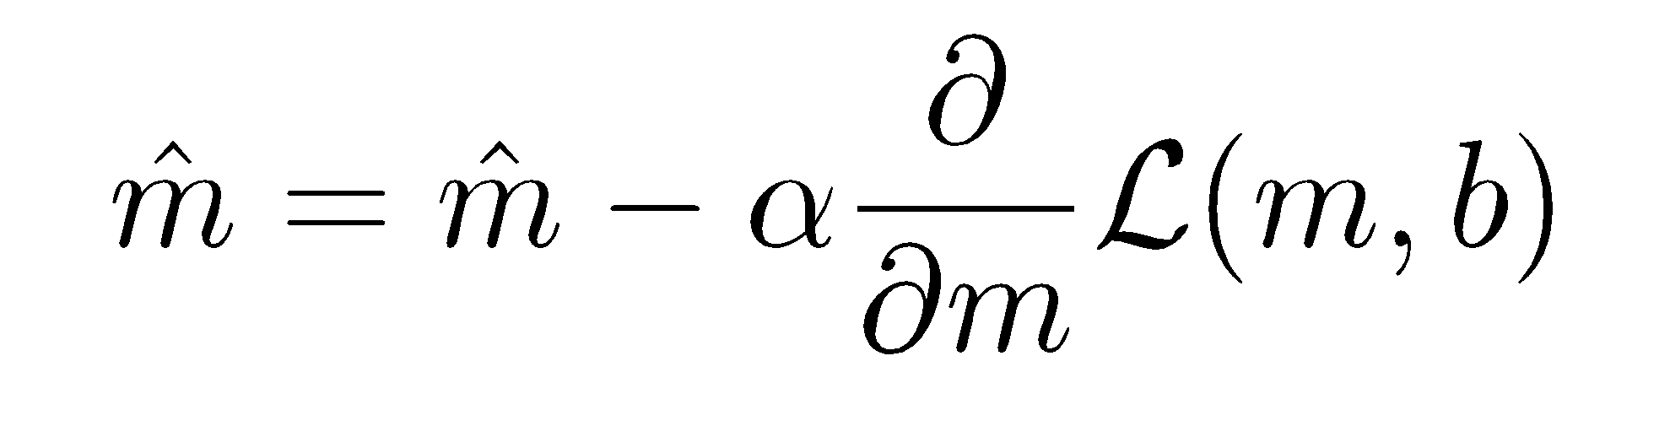
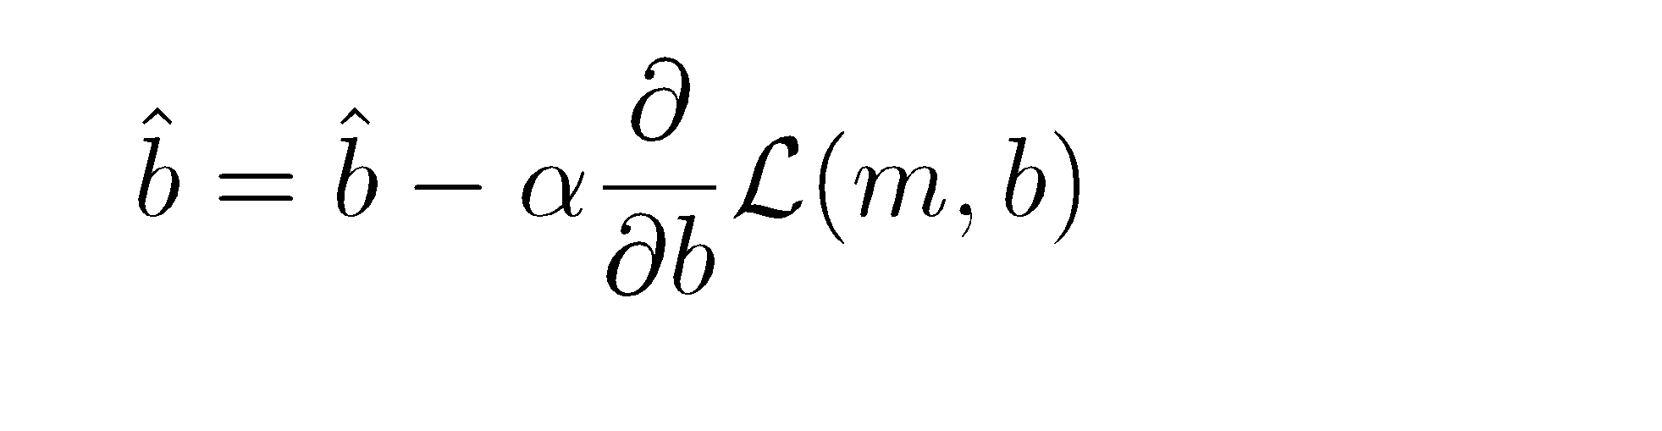
Gradient Descent Algorithm
Repeat until convergence:
The α parameter is called the learning rate
The gradients were what we just derived
As we approach a local minimum, gradient descent will automatically take smaller steps. So, no need to decrease α over time

Slide 53
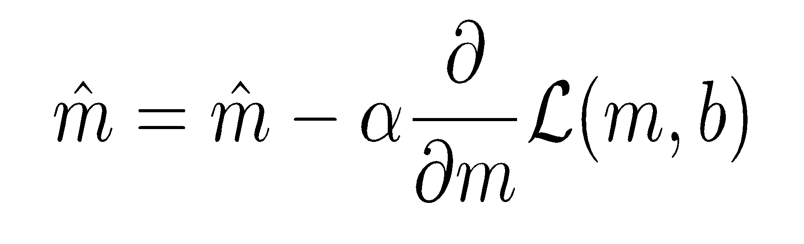
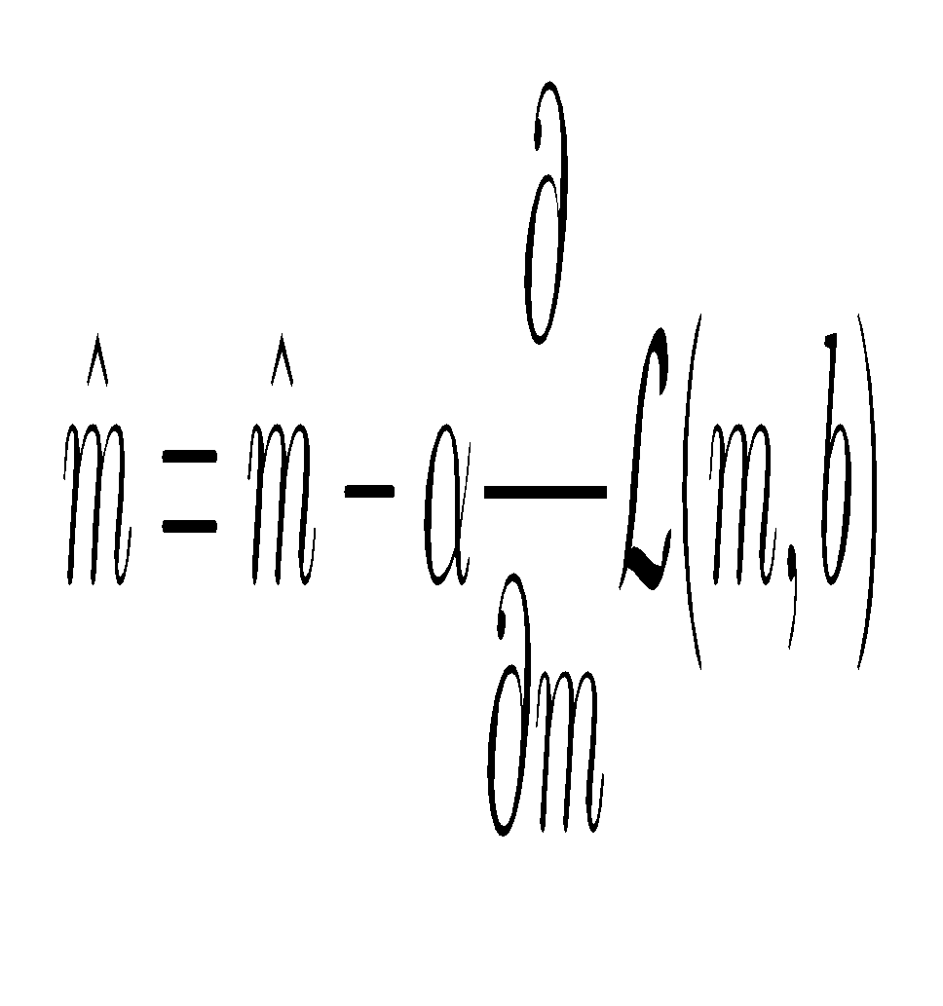
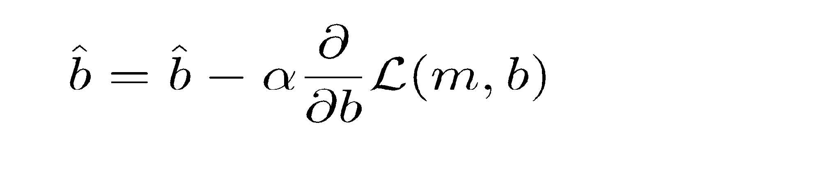
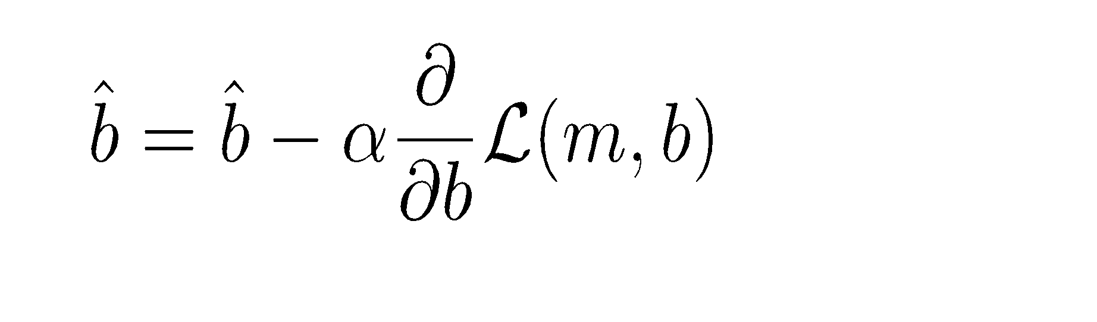
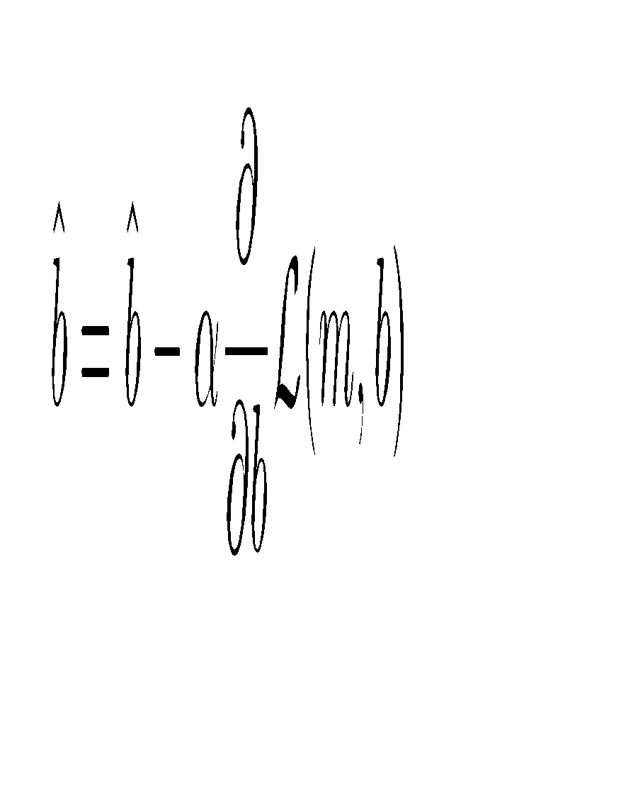
Updating Multiple Parameters
Simultaneously update (not independently update)
temp_{m}
temp_{m}
temp_{m}
temp_{b}
temp_{b}
temp_{m}
temp_{b}
temp_{b}

Slide 54
Some terminology
Epoch - When you’ve trained through the entire dataset
Sample - A single data sample
Mini-batch - A subset of the full set of data (or the batch)
Stochastic - Random (e.g., SGD)
Training / Validation / Test - Splits of your dataset

Slide 55
How much data should you use each step?
Could use all the data in the entire dataset and each time take a step in the direction of the gradient?
  Batch Gradient Descent
Could calculate a single datapoint for each step in the direction of the gradient?
  Stochastic Gradient Descent
Could randomly sample a batch and then for each batch, take a step in the direction of the gradient?
  Minibatch Stochastic Gradient Descent
Notes:
https://towardsdatascience.com/batch-mini-batch-stochastic-gradient-descent-7a62ecba642a

Slide 56
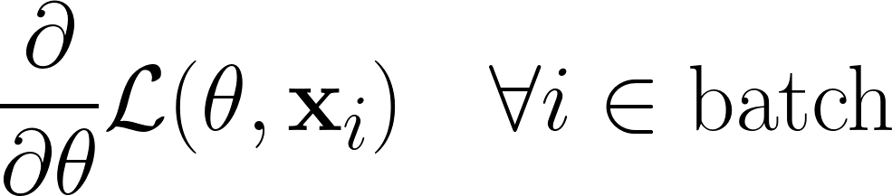
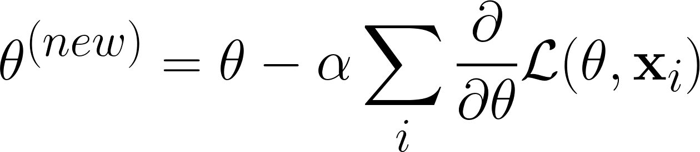
So what does minibatch SGD look like?
Take a random batch from your data
Calculate your gradient for each point in the random batch
Sum the gradients together and then update gradient

Slide 57
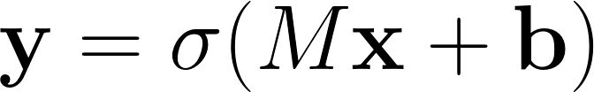

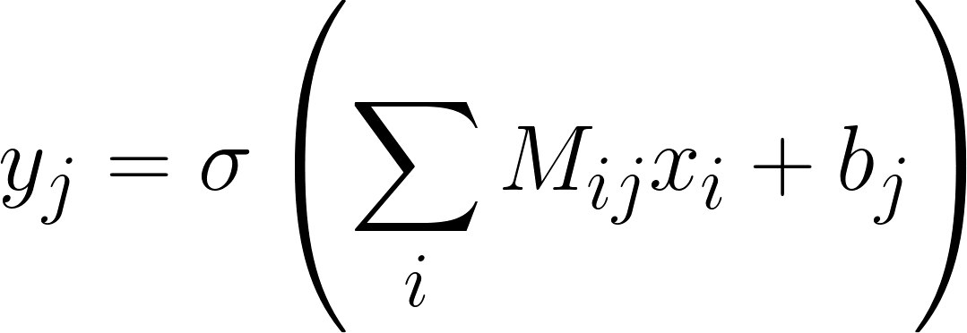

Logistic Regression Representation
1
z₁
σ
y₁
x₁
z₂
σ
y₂
z₃
σ
y₃
x₂

Slide 58
Logistic Regression Representation
1
y₁
x₁
y₂
y₃
x₂

Slide 59
Layering Logistic Regression
1
x₁
x₂
Input Layer
Hidden Layer
Hidden Layer
Output Layer

Slide 60
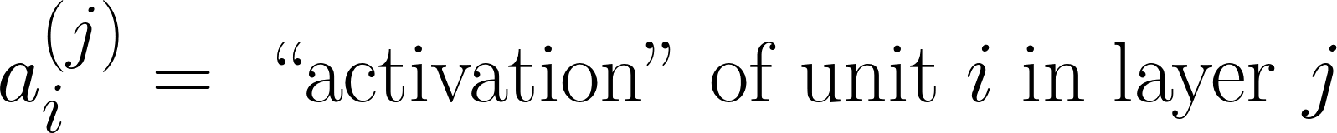
Neural Networks Representation

Slide 61
Section 2: Machine Learning
Linear algebra
Gradients and the chain rule
How ML toolboxes work

Slide 62
Review and Expected Knowledge
Concepts reviewed here
Basic linear algebra
Basic multivariate calculus
Principles of neural networks and deep learning
Additional reading
Linear Algebra: https://cs229.stanford.edu/section/cs229-linalg.pdf
Matrix Calculus for DNNs: https://arxiv.org/pdf/1802.01528

Slide 63
Convention and Notation
A - Matrices are capital script
v - vectors are lowercase bold
a - scalars are italicized
Subscripts denote dimensions of the vector
Superscript with parentheticals are sample number

Slide 64
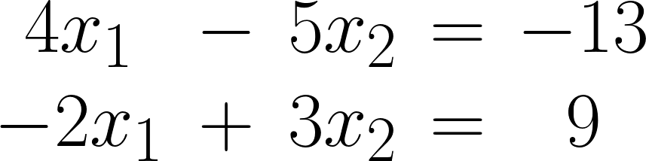

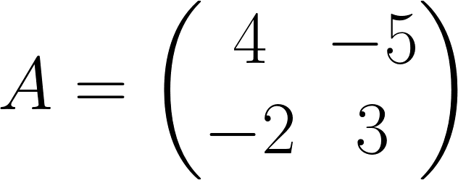
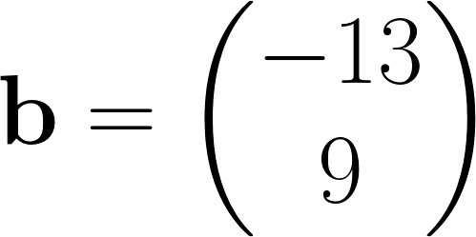
A Review of Linear Algebra: Basic Notation
Notes:
https://cs229.stanford.edu/section/cs229-linalg.pdf
\begin{matrix}
4x_1 & - & 5 x_2 & = & -13 \\
-2x_1 & + & 3 x_2 & = & 9
\end{matrix}
A\textbf{x} = \textbf{b}
A = \begin{pmatrix} 4 & -5 \\ -2 & 3 \end{pmatrix}

Slide 65
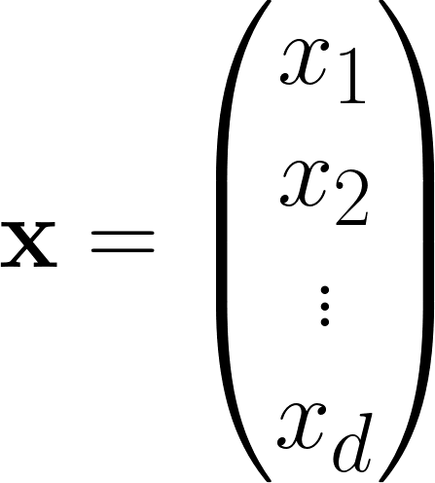
A Review of Linear Algebra: Vectors
Traditionally written as vertical vectors, where vectors are bolded script
Scalars are written as italicized unbolded script, where subscript is a dimension of the bolded vector.

Slide 66
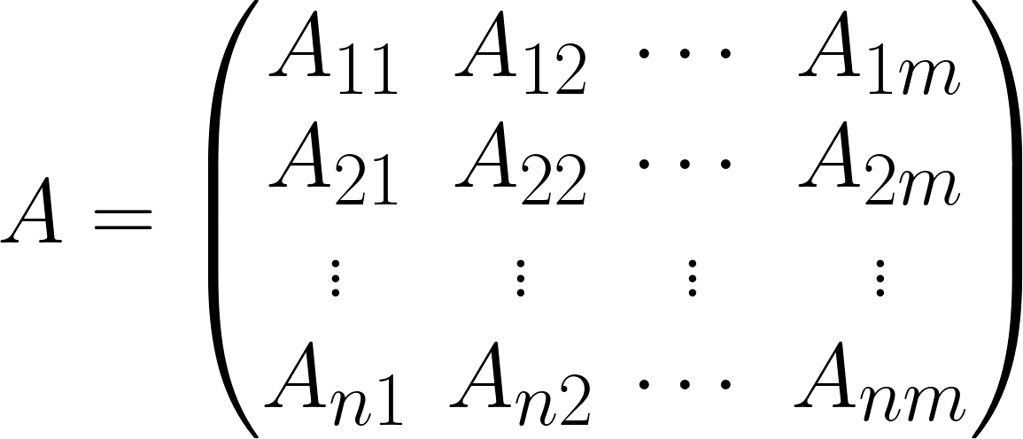

A Review of Linear Algebra: Basic Notation
Notes:
A = \begin{pmatrix} A_{11} & A_{12} &\cdots & A_{1d} \\ A_{21} & A_{22} & \cdots & A_{2d} \\
\vdots & \vdots & \vdots & \vdots \\
A_{n1} & A_{n2} & \cdots & A_{nd}
\end{pmatrix}

Slide 67

A Review of Linear Algebra: Basic Notation
Transpose is the superscript T

Slide 68


A Review of Linear Algebra: Basic Notation
Notes:
A^T = \begin{pmatrix} A_{11} & A_{12} &\cdots & A_{1m} \\ A_{21} & A_{22} & \cdots & A_{2m} \\
\vdots & \vdots & \vdots & \vdots \\
A_{n1} & A_{n2} & \cdots & A_{nm}
\end{pmatrix}^T =
\begin{pmatrix} A_{11} & A_{21} &\cdots & A_{n1} \\ A_{12} & A_{22} & \cdots & A_{n2} \\
\vdots & \vdots & \vdots & \vdots \\
A_{1m} & A_{2m} & \cdots & A_{nm}
\end{pmatrix}

Slide 69


A Review of Linear Algebra: Products
Vector - Vector Product
Notes:
\textbf{x}\cdot\textbf{y} = \textbf{x}^T\textbf{y} = \begin{pmatrix} x_1 & x_2 & \cdots & x_n \end{pmatrix} \begin{pmatrix} y_1 \\ y_2 \\ \vdots \\ y_n \end{pmatrix}

Slide 70



A Review of Linear Algebra: Products

Slide 71



A Review of Linear Algebra: Products
Matrix - Vector Product
Notes:
\textbf{y} = A \textbf{x} =
\begin{pmatrix}
\text{---} & \textbf{a}^T_1 & \text{---} \\
\text{---} & \textbf{a}^T_2 & \text{---} \\
\vdots \\
\text{---} & \textbf{a}^T_n & \text{---} \\
\end{pmatrix}
\textbf{x} =
\begin{pmatrix}
\textbf{a}_1^T\textbf{x} \\
\textbf{a}_2^T\textbf{x} \\
\vdots \\
\textbf{a}_n^T\textbf{x}
\end{pmatrix}
—------------------------------------
\textbf{y} = A \textbf{x} =
\begin{pmatrix}
\vert & \vert & & \vert \\
\textbf{a}_1 & \textbf{a}_2 & \cdots & \textbf{a}_n \\
\vert & \vert & & \vert
\end{pmatrix}
\begin{pmatrix} x_1 \\ x_2 \\ \vdots \\ x_n \end{pmatrix}
—------------------------------------
= \begin{pmatrix} \vert \\ \textbf{a}_1 \\ \vert \end{pmatrix} x_1 + \begin{pmatrix} \vert \\ \textbf{a}_2 \\ \vert \end{pmatrix} x_2 + \cdots \begin{pmatrix} \vert \\ \textbf{a}_n \\ \vert \end{pmatrix} x_n

Slide 72

A Review of Linear Algebra: Products
Usually, you use: y = Ax. You can also take the transpose
Notes:
\begin{matrix}
\textbf{y}^T &=& \textbf{x}^T A \\
&=& \begin{pmatrix}
x_1 & x_2 & \cdots x_n
\end{pmatrix}
\begin{pmatrix}
\text{---} & \textbf{a}_1^T & \text{---} \\
\text{---} & \textbf{a}_2^T & \text{---} \\
& \vdots & \\
\text{---} & \textbf{a}_n^T & \text{---}
\end{pmatrix}
\\
&=& x_1
\begin{pmatrix}
\text{---} & \textbf{a}_1^T \text{---}
\end{pmatrix}
+
x_2
\begin{pmatrix}
\text{---} & \textbf{a}_2^T \text{---}
\end{pmatrix}
+
\cdots
x_n
\begin{pmatrix}
\text{---} & \textbf{a}_1^T \text{---}
\end{pmatrix}
\end{matrix}

Slide 73


L₂-Norm and Inverse

Slide 74
Section 2: Machine Learning
Linear algebra
Gradients and the chain rule
How ML toolboxes work

Slide 75


Symbols and Terminology
Product from i=1 to N:
Sum from i=1 to N:

Slide 76



Properties of Logs
Log of product = sum of logs
Log of product = sum of logs
Log of exponent = argument

Slide 77


Basic derivatives
Derivative of x to the power of d:
Derivative of a constant

Slide 78


Derivatives
Derivative of log
Chain Rule
Example of Chain Rule in the next slide
Notes:
% \frac{\partial}{\partial x} \log (x^2) = \frac{\partial \log (x^2)}{\partial x^2} \frac{\partial x^2}{ \partial x}

Slide 79







Example of Chain Rule
Let’s try to find:
Let
Notes:
\frac{\partial}{\partial x}\log (x^2) = \frac{\partial \log u}{\partial u} \cdot \frac{\partial u}{\partial x}

Slide 80
Diagrammatically
f1
a
f2
b
f3
c
f4
d
f5
e
x
deriv f₅( f₄ ( f₃ (f₂ (f₁ (x) ) ) ) ) = f₅’(d) x f₄’(c) x f₃’(b) x f₂’(a) x f₁’(x)
Notes:
\frac{\partial e}{\partial x} = \partial f_1 \left( f_2 \left( f_3 \left( f_4 \left( f_5 (x) \right) \right) \right) \right) / \partial x = \partial f_5 / \partial d + \partial f_4 / \partial c + \partial f_3 / \partial b + \partial f_2 / \partial a + \partial f_1 / \partial x

Slide 81


The sigmoid function example
Sigmoid function
Derivative of a sigmoid function

Slide 82

The Logistic Regression
𝝈( . )
Apply Weights W
Add Bias b
What’s the gradient? … with respect to the weights? Bias?

Slide 83



The Two Layer Neural Network
Arrows are the neural network layers
layer1
layer2
layer1
layer2
BCE loss
x
h
data node
output data node

Slide 84
Decoding the Keras Code

Slide 85

Going Over Deep Learning in Practice
Reviewing the MNIST Keras Example
Deep Learning Model

Slide 86

Setting up

Slide 87
Importing a framework

Slide 88











The Many Deep Learning Frameworks

Slide 89
Setting up data with some preprocessing

Slide 90
Getting data into the right format
Most often 90% of the job
MNIST has been used over and over, so it’s easy to use (it’s in the Tensorflow packages)
Many use offline preprocessing to manipulate and preprocess the data (you should be intimately familiar with Map Reduce jobs)

Slide 91


Typical Preprocessing
Resilient Distributed Dataset / DataFrames
Scala, Python, SQL, Java, R
Orthogonal interface with existing services
More Pandas-like and analysis driven
PCollections / PTable / PSequence
C++, Python, Java, Typescript SDKs
Integrates well with serving infrastructure
More Machine-learning and pipeline driven

Slide 92
Input Batches Have Fixed Dimensionality
Deep Network
Input
Labels

Slide 93
Except When They Don’t
Convolutional Neural Networks & Recurrent Neural Networks
Deep Network
Stream of Data

Slide 94
Except When They Don’t
Convolutional Neural Networks & Recurrent Neural Networks
Deep Network
Stream of Data

Slide 95
Except When They Don’t
Convolutional Neural Networks & Recurrent Neural Networks
Deep Network
Stream of Data
Notes:
What’s in the output batch? Embeddings? Classification?

Slide 96

Dimensions of it all
Images: width x height x depth x batch size
Text: vocab encoding size x window width x batch size
Time Series: window width x batch size
Graph processing: embedding lookups

Slide 97

Building the Model

Slide 98

All the Different Layers
Combatting Overfitting
Convolutional
Regularization
Pooling Layers
Dense Layers
Flatten Layers
And Much More

Slide 99


Pooling / Max Pooling
Notes:
Pooling layers are used to reduce the dimensions of the feature maps. Thus, it reduces the number of parameters to learn and the amount of computation performed in the network.
The pooling layer summarises the features present in a region of the feature map generated by a convolution layer. So, further operations are performed on summarised features instead of precisely positioned features generated by the convolution layer. This makes the model more robust to variations in the position of the features in the input image.

Slide 100
Building the Model

Slide 101

What loss curve should you use?
https://keras.io/api/losses/
Losses should diminish over time
for N data points where t is the truth value taking a value 0 or 1 and p is the softmax probability for the ith data point.

Slide 102

You can also specify your own loss

Slide 103

Takes the Gradient of Your Function
Optimizations are variants of Minibatch Stochastic Gradient Descent

Slide 104
Automatic Differentiation

